Slide 1

AI/ML based assisted screening of anemia using patient images
for remote diagnosis
Dual Degree Project Stage 1 Presentation
Presented By - Shrey Gupta (190100112)
Industry Partner: Intelehealth
Mentors: Mr. Ramesh (CTO)
Dr. Neha (CEO)
Guide: Dr. Nirmal Punjabi
Co-Guide: Prof. Ganesh Ramakrishnan

Slide 2
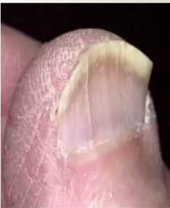
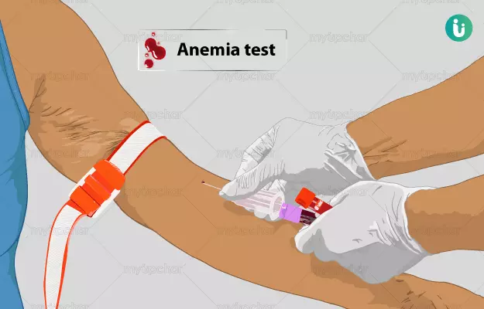
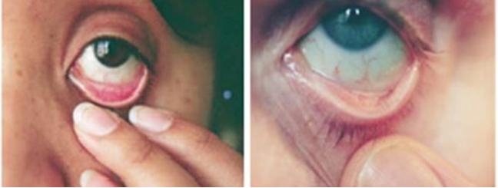
Background
Hemoglobin is essential for oxygen transport in the bloodstream
Low hemoglobin levels result in anemia which affects around 1.6 Billion people worldwide ^{[1]}
Anemia can be congenital or acquired, with iron-deficiency anemia being the most common form
Anemia is often asymptomatic until it reaches a severe stage, with symptoms like fatigue, dizziness, and pallor
Traditional invasive methods for anemia detection have limitations, especially for certain age groups
Non-invasive methods, like assessing visible pallor in exposed tissues, are in demand for easier, rapid diagnosis
Normal
Anemic
slideshare.net
myupchar.com
semanticscholar.org

Slide 3
Project Flow
LITERATURE
REVIEW
HYPOTHESIS
DATASET
SUMMARY & FUTURE WORK
RESULTS & COMPARISON
METHODOLOGY

Slide 4
Methodology for Literature Review
Best 5 papers
Based on evaluation metrics such as sensitivity, accuracy and recall, number of people and dataset size
5
Reading full paper
Going in-depth of 50 shortlisted papers to decide the best 5 papers
4
Reading abstracts
Papers shortlisted - 50
3
Reading titles
Papers removed contained a subset of following keywords
Use of PPG signals
Validation of devices like Masimo Radical-7 SpHb Station
Validation of some embedded platform
Review of hemoglobin measurement devices
Total papers left - 100 (approx)
2
Total Papers
Sources
google scholar
pubmed
scopus.
Keywords
“non-invasive”
“anemia”
“automated screening”
“smartphone”
“hemoglobin measurement”
Total - 600 (approx)
1

Slide 5
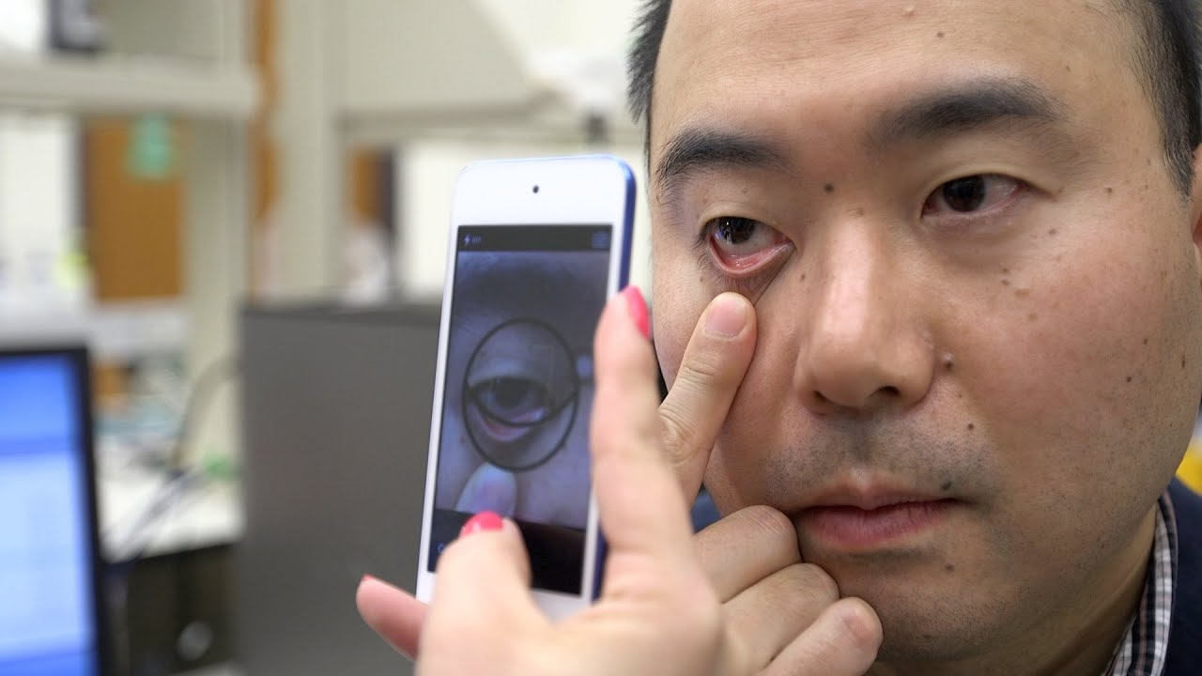
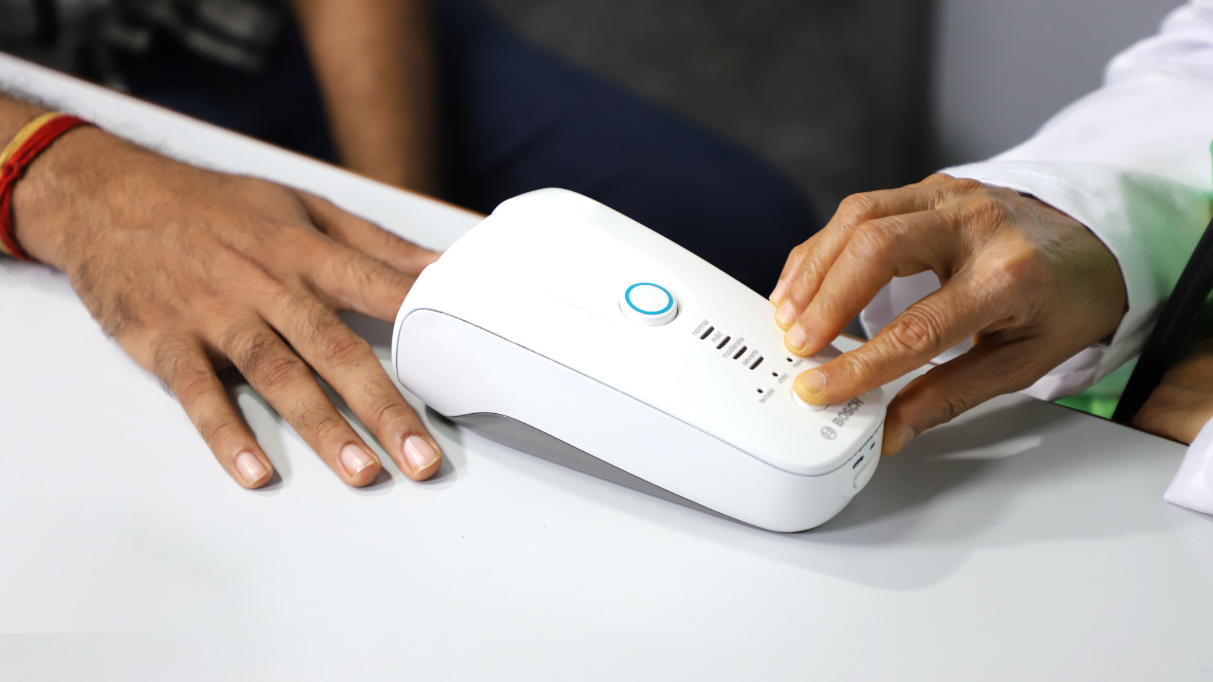
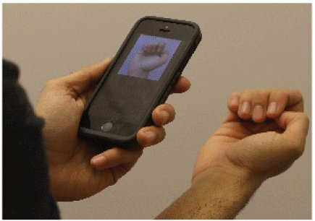
Key Questions
What prior work existed before using smartphone images?
What prior work existed before using smartphone images?
What are the advantages and limitations of using smartphone images over PPG signals?
What prior work exists using smartphone images?
Which body location is best for determining pallor via smartphone image?
healthcareradius.in
medicalxpress.com
newatlas.com

Slide 6
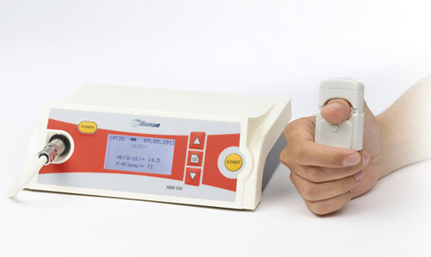
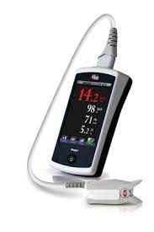
Answers to Key Questions
1. What prior work existed before using smartphone images?
Before 2019
Research was focused on using PPG signals
Devices
NBM-200
Pronto-7
Haemospect
NBM-200
Research focus
Validation of above in various medical cases
Use of ML models to determine the haemoglobin using PPG signals
Advantages:
Non-invasive
Continuous monitoring
Quick measurement in comparison to CBC test
ncbi.nlm.nih.gov
Limitations:
Indirect measurement
Interference
Pronto-7
Notes:
Advantages:
Non-invasive: PPG can be measured using wearable devices, making it more convenient and comfortable for patients.
Real-time monitoring: PPG provides continuous, real-time data, allowing for dynamic monitoring of hemoglobin levels.
Cost-effective: PPG devices are generally more affordable compared to medical imaging equipment
Limitations:
Indirect measurement: PPG signals provide an indirect estimation of hemoglobin levels based on changes in blood volume.
Accuracy and precision: The accuracy and precision of PPG-based hemoglobin estimation may not be as high as traditional laboratory methods, such as blood tests..
Interference: PPG signals are sensitive to motion artifacts and external light sources

Slide 7
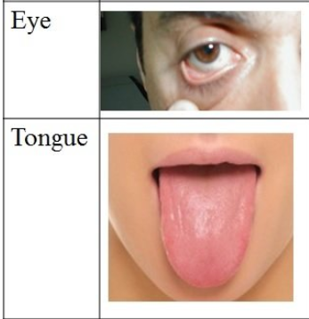
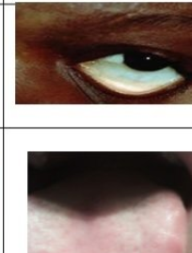
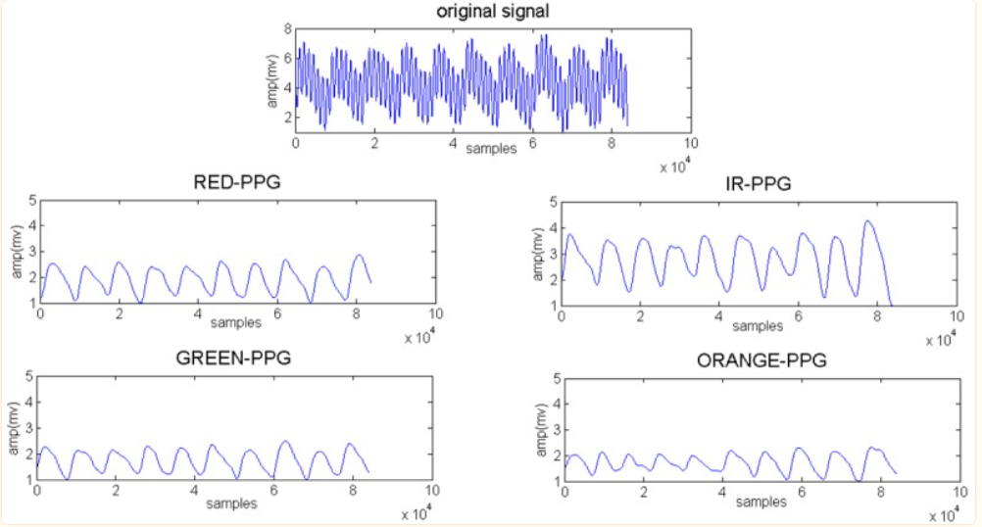
Answers to Key Questions
2. What are the advantages & limitations of using smartphone images over PPG signals?
Advantages
Accessibility
Cost-Effective
Integration with medical practitioners
Limitations
Lighting Conditions
Calibration and Standardization
Dependence on Image Quality
ncbi.nlm.nih.gov
researchgate.net
Notes:
Color information: Hemoglobin carries oxygen, which affects the color of blood. Images can capture these color variations, and certain imaging techniques like hyperspectral imaging can even quantify hemoglobin levels based on spectral analysis of the captured colors.
Ease of integration with existing technology: Many medical facilities already have imaging equipment, such as cameras or smartphones, which can be readily used for capturing images, making it a cost-effective option.
Objective and standardized analysis: Advanced imaging techniques can allow for objective and standardized analysis of hemoglobin levels, reducing inter-operator variability often seen in manual PPG signal analysis.
Potential for remote assessment: Images can be captured and transmitted remotely, allowing healthcare professionals to assess patients' conditions in telemedicine or remote healthcare setups.
Non-contact or minimally invasive: Some imaging techniques are non-contact or minimally invasive, minimizing patient discomfort and risk of infection

Slide 8
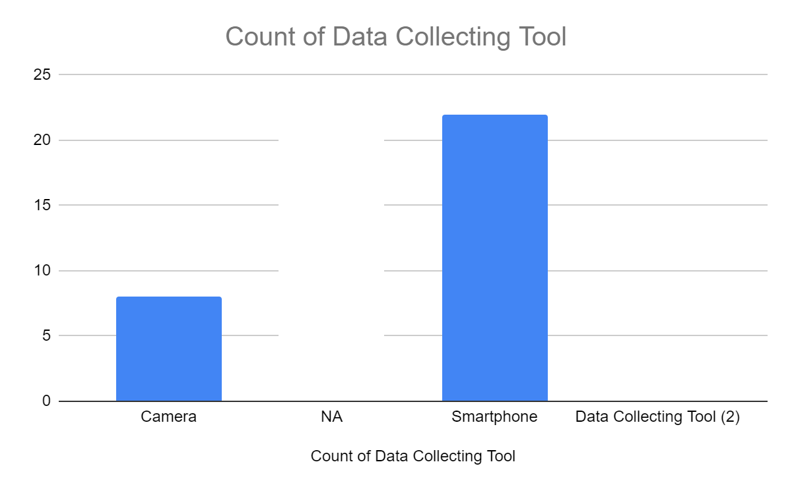
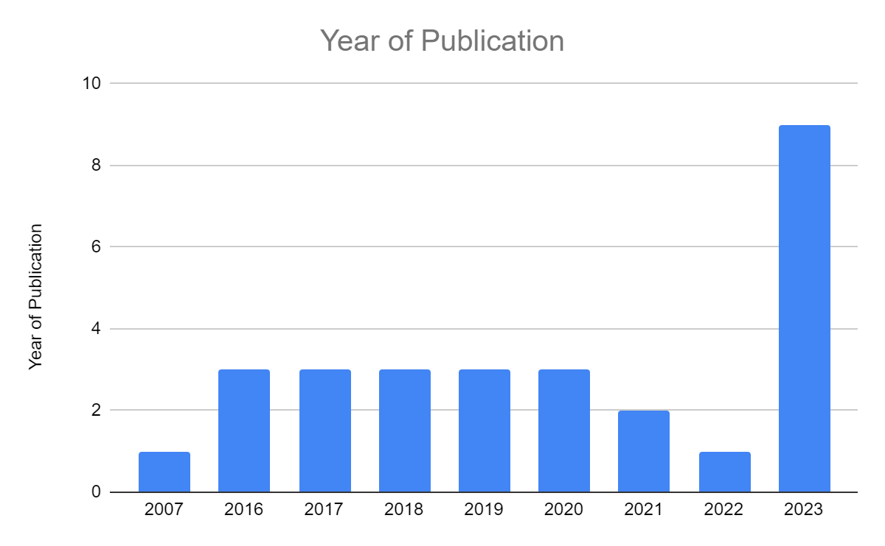
Answers to Key Questions
3. What prior work exists using smartphone images?
After 2019
Research shifted towards using smartphone\digital camera
Researchers used images of anatomic parts
palm
conjunctiva
fingernail bed
tongue to determine the hemoglobin level
Reason
Few melanin-producing skin cells
Correlation between the degree of paleness and hemoglobin content ^{[1,2]}
Notes:
Researchers have widely used conjunctiva images for hemoglobin estimation due to its rich vascularization and the fact that pale conjunctiva is most common symptoms of anemia
Coming to machine learning algorithms, there a wide range of machine learning algorithms being used starting from regression to neural networks or decision trees.

Slide 9
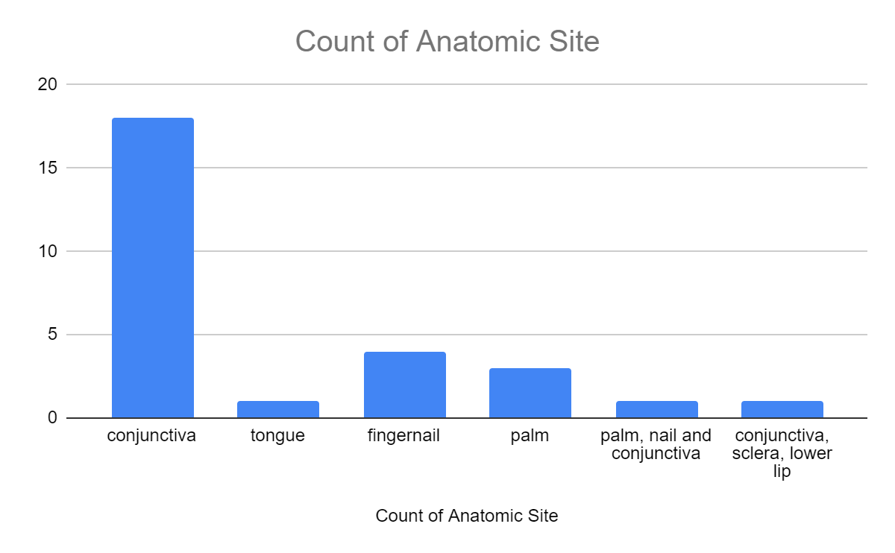
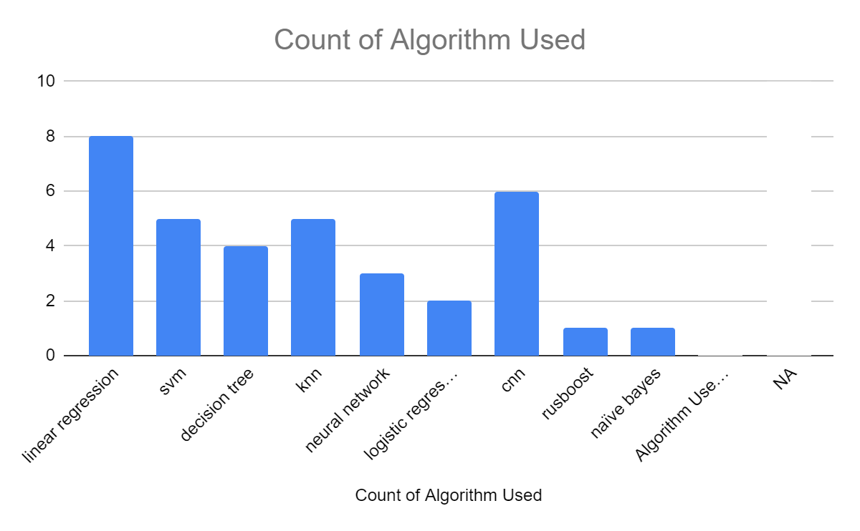
Answers to Key Questions
4. Which body location is best for determining pallor via smartphone image?

Slide 10
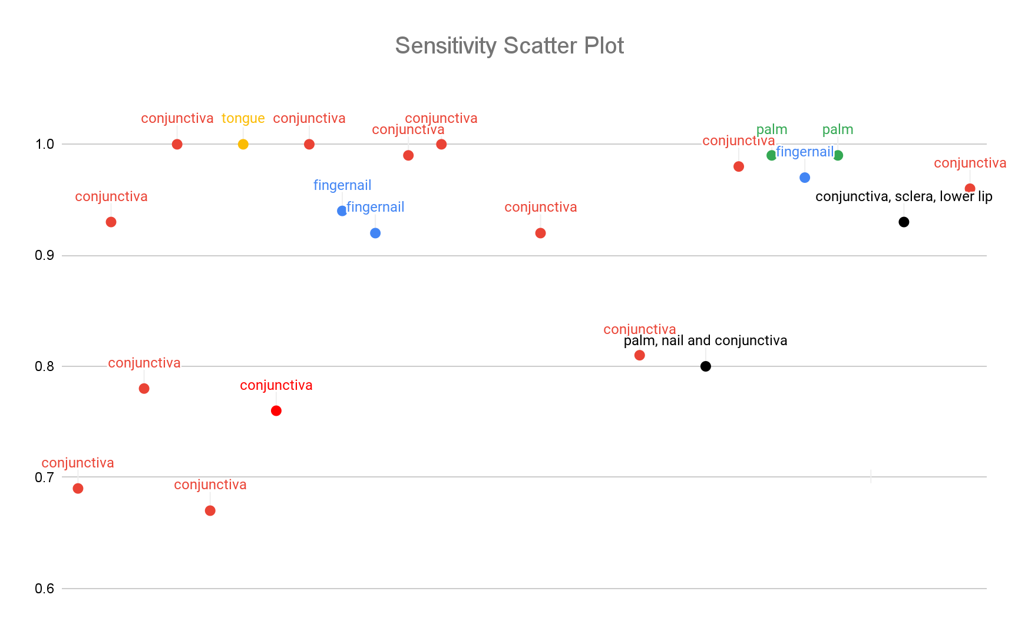
Answers to Key Questions
4. Which body location is best for determining pallor via smartphone image?
Anatomic Site | COUNTA of Anatomic Site
conjunctiva | 18
conjunctiva, sclera, lower lip | 1
fingernail | 4
palm | 3
palm, nail and conjunctiva | 1
tongue | 1
Grand Total | 28

Slide 11
Summary
Sr No | Title of Paper | Author | Anatomic Site | Year of Publication | Study Location | No. of people | Accuracy | Sensitivity | Precision | Specificity
1 | Detection of iron deficiency anemia by medical images: a comparative study of machine learning algorithms | Peter Appiahene et al | palm | 2023 | Ghana | 527 | 0.99 | 0.99 | 0.99 | NA
2 | Iron deficiency anemia detection using machine learning models: A comparative study of fingernails, palm and conjunctiva of the eye images | Justice Williams Asare et al | palm | 2023 | Ghana | 710 | 0.98 | 0.99 | 0.99 | NA
3 | A Deep Learning-based System for Detecting Anemia from Eye Conjunctiva Images Taken from a Smartphone | Pallavi et al | conjunctiva | 2023 | India | 300 | 0.97 | 0.96 | 0.94 | NA
4 | Non-Invasive Detection of Anaemia Using Digital Photographs of the Conjunctiva | Shaun Collings et al | conjunctiva | 2016 | New Zealand | 106 | NA | 0.93 | NA | 0.72
5 | Smartphone app for non-invasive detection of anemia using only patient-sourced photos | Robert G. Mannino et al | fingernail | 2018 | United States | 337 | NA | 0.92 | NA | 0.76
6 | Non-Invasive Measurement of Hemoglobin Using Smartphone | R. Mala et al | palm, nail and conjunctiva | 2023 | India | 115 | 0.8 | 0.8 | 0.94 | 0.8
7 | Feasibility of smartphone colorimetry of the face as an anaemia screening tool for infants and young children in Ghana | Thomas Alan Wemyss et al | conjunctiva, sclera, lower lip | 2023 | Ghana | 62 | 0.91 | 0.93 | 0.81 | 0.89
Link to full comparison table

Slide 12
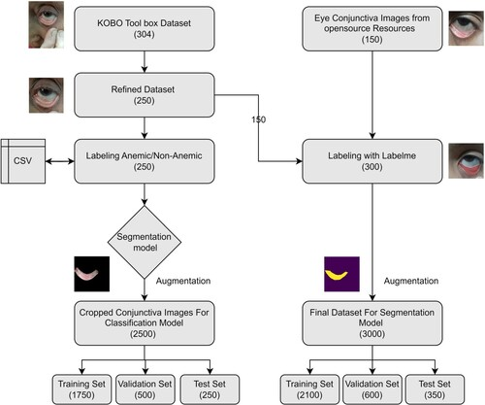
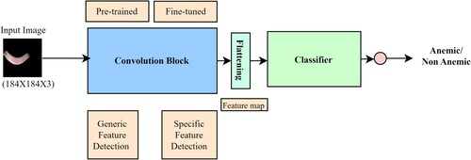
Pallavi et al [3]
Aim
Develop an Artificial Intelligence (AI)-based bot to screen people for anemia
Complete workflow
Methodology
Data collection of 300 people using KOBO Tool box
160 anemic cases
140 non-anemic
Used some open-sourced eyes images with conjunctiva parts available on the internet
Generated ROI using “Labelme” software and fully convolutional networks (FCN)
Data augmentation to avoid the overfitting such as position-based and pixel-based algorithms
70:20:10 split for training, validation and testing sets
Conclusion
ResNet-34 had the best performance
IOU of 0.9272
Validation accuracy of 0.9699
Validation precision of 0.9415
Validation recall of 0.9571
Representation of the architecture of the classification mode
tandfonline.com

Slide 13
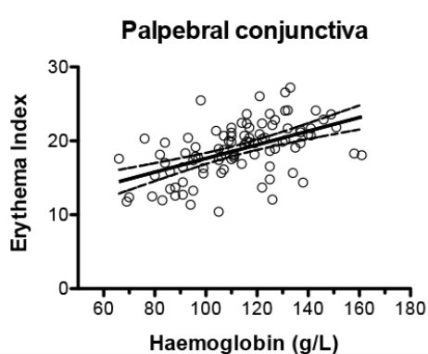
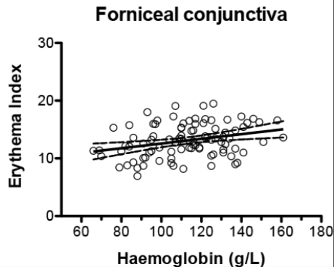
Shaun Collings et al [4]
Aim
Detect anaemia by conjunctival pallor using digital photographs taken with a smartphone.
Methodology
Collect data from 106 people using Panasonic DMC-LX5 digital camera and iPhone 5S smartphone
Screen images on the basis of quality of photographs
Extract erythema index (EI) and fit a linear curve using the sum-of-squares method with EI as parameters
EI = log(S_{red}) − log(S_{green})
where S is the brightness of the conjunctiva in the relevant colour channel
Relationship between EI and Haemoglobin in conjunctiva
Conclusion
Camera
Sensitivity 0.93
Specificity 0.72
Smartphone
Sensitivity 0.93
Specificity 0.66
journals.plos.org

Slide 14
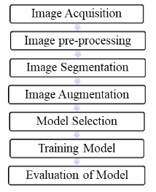
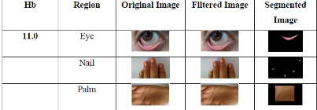
R. Mala et al [6]
Aim
Develop a non invasive method using digital images of eye, palm and nail bed
Methodology
Acquire images of eye, palm and nail bed from 115 people
Create a segmentation mask using RGB colour space, HSV colour space and L*a*b* colour space
Extract the below mentioned features from each anatomic site (total 9 features)
Features Extracted
Mean of a *value
Standard deviation of a* value
Ratio between mean of red value to the mean of green value
Trained a linear regression model
Workflow
Conclusion
Precision 94%
Accuracy, Sensitivity and Specificity of 80%
harbinengineeringjournal.com

Slide 15
Hypothesis
Summary (till now)
In a review of over 50 papers spanning the past two decades, only a handful (1-2) explored the collective use of image parameters from various exposed body tissues like the tongue, palm, fingernail, and conjunctiva.
These individual anatomical features demonstrated promising accuracy and sensitivity, suggesting that a combination of their best parameters could yield a more robust and accurate machine learning model.
Hypothesis 1
“Combination of one anatomy (say conjunctiva) with patient demographics (such as age,gender) as parameters will result in a robust and better prediction model.”
Hypothesis 2
“Combination of multiple anatomies as parameters will result in a robust and better prediction model.”

Slide 16
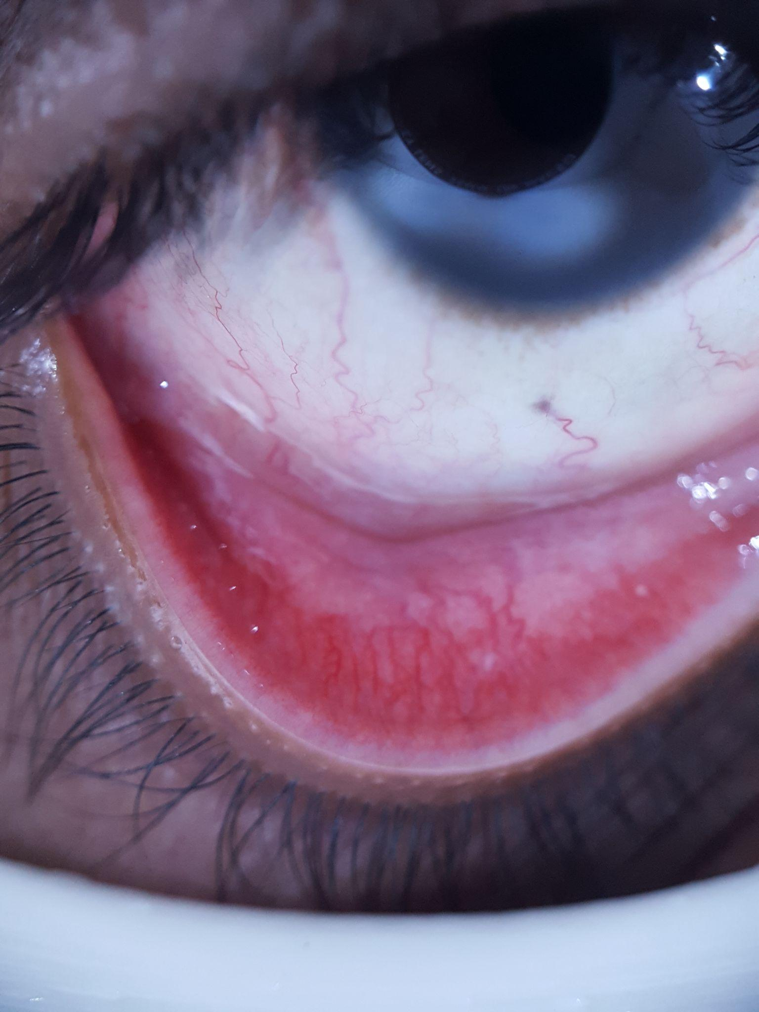
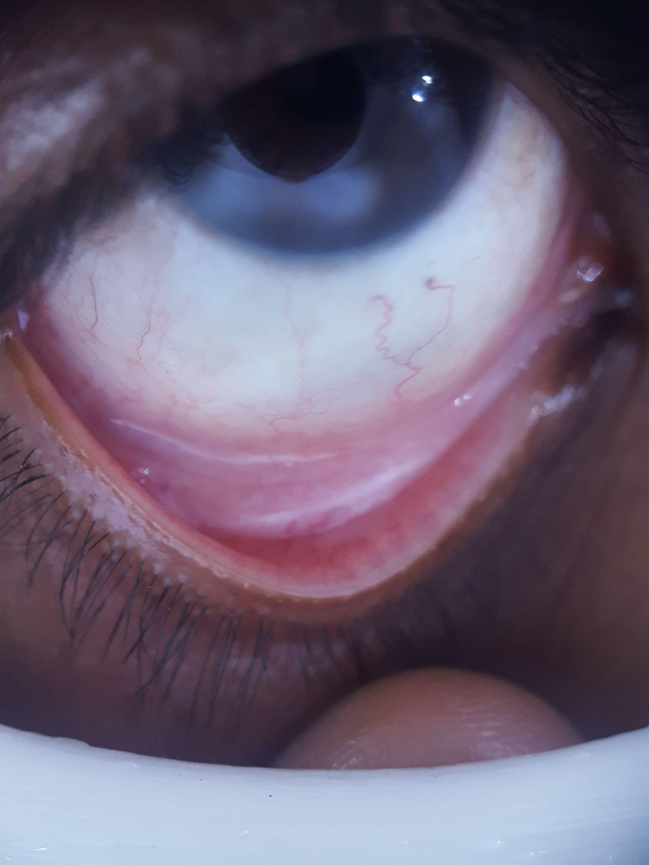
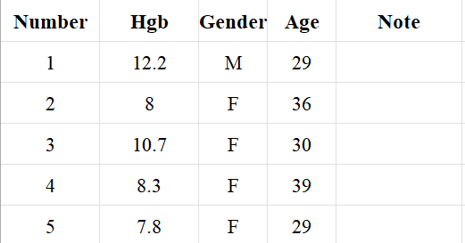
Data Collection
Hypothesis 1:
IEEE dataset containing 95 eye images along with segmented conjunctiva and patient demographics (provided by the Intelehealth Team)
(dataset described in the next slide)
Hypothesis 2:
Data Collection part is pending
Working on the IEC proposal for the collection of data with the Intelehealth team
Number - 1 (Non-Anemic)
Number - 2 (Anemic)
Snippet of patient demographics

Slide 17
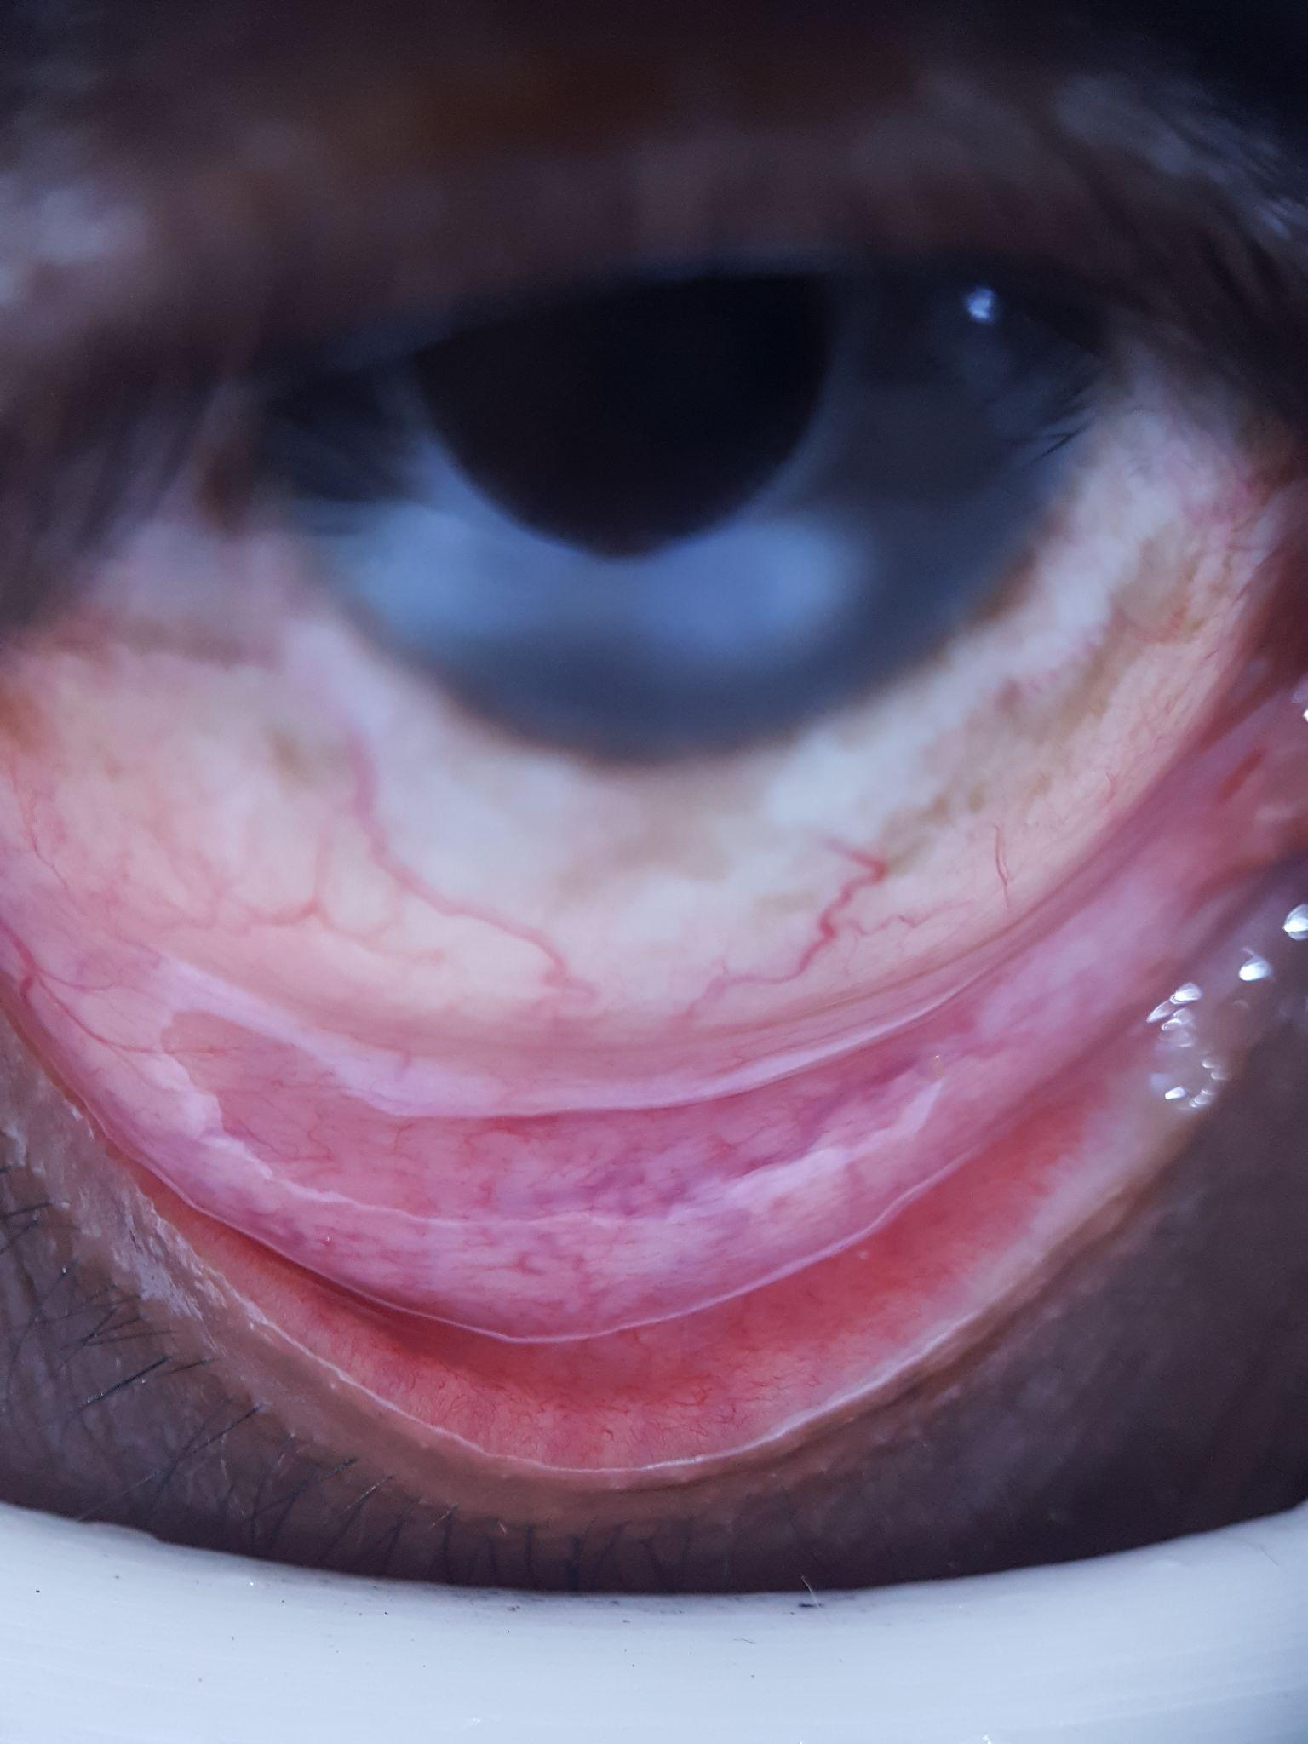
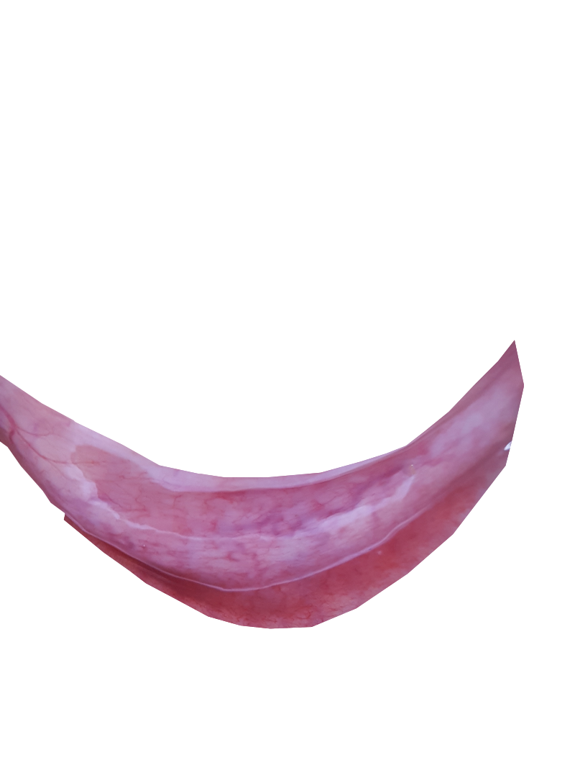
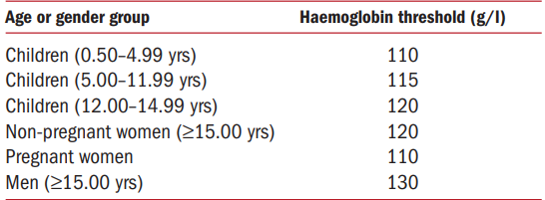
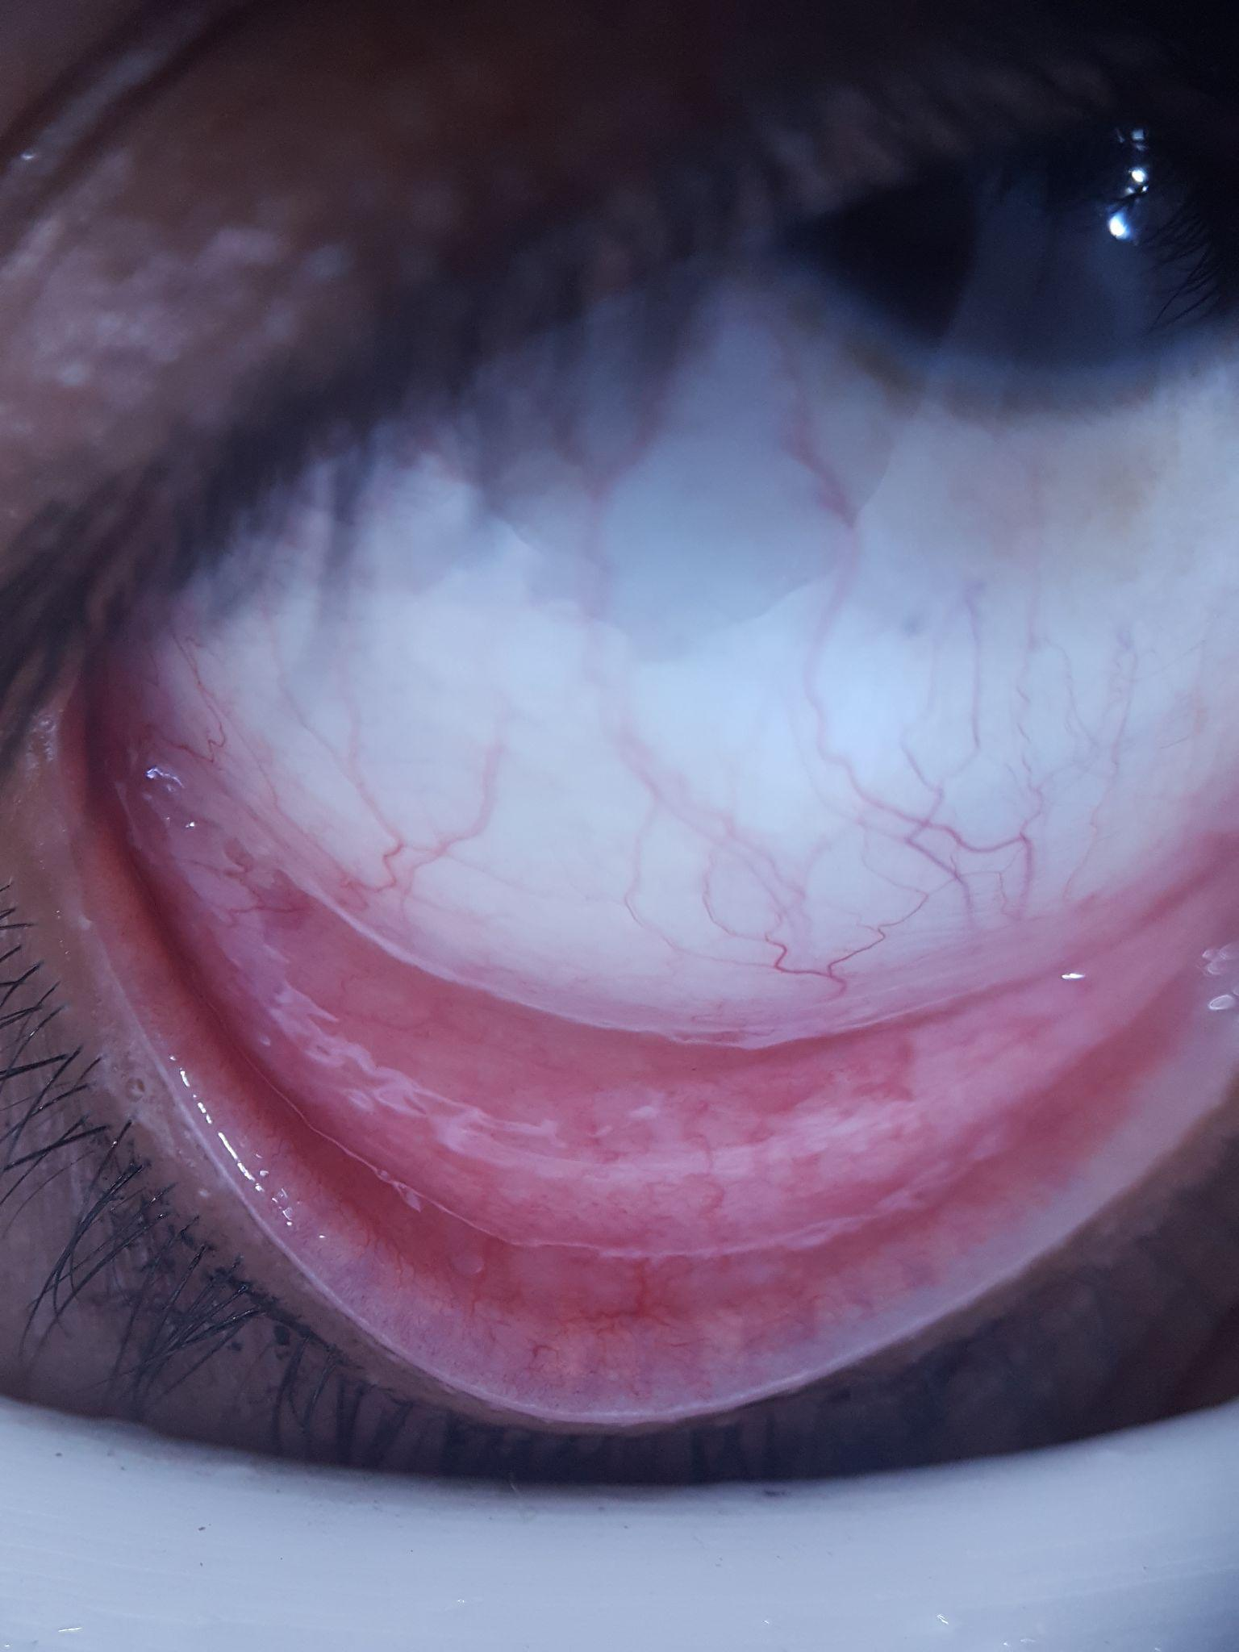
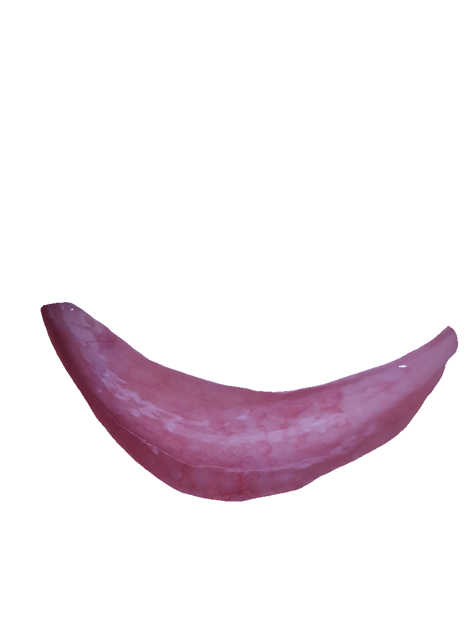
Current Dataset
95 Indian eye-images
Segmented conjunctiva
forniceal conjunctiva
palpebral conjunctiva
Combination of forniceal conjunctiva and palpebral conjunctiva
Patients’ demographics such as age and gender
Hemoglobin level when the photo of eye was taken
Haemoglobin thresholds used to define anaemia
Non-Anemic
For Classification
Threshold - 11.0 g/dL
Non-Anemic (label) - 0
Anemic (label) - 1
For Regression
Hgb values as targets
iris.who.int
Anemic
https://doi.org/10.3390/electronics9060997

Slide 18
Methodology
Eye Image
ROI
Dataset
Segmentation
Augmentation
Feature Extraction
Anemic
OR Non-Anemic
Classification
Feature Selection
Exploratory Data Analysis
Hemoglobin Values
Regression

Slide 19
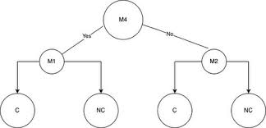
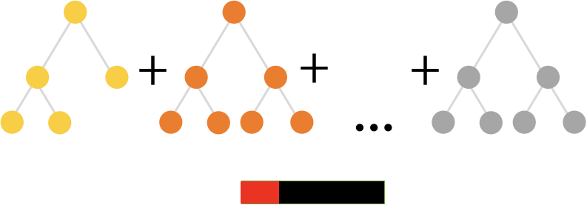
Methodology: Algorithms
Decision Trees
Decision Tree Classifier is a machine learning algorithm used for classification tasks
It creates a tree-like structure where each internal node represents a decision or a test on a feature, and each leaf node represents a class label
It is simple to understand and interpret, making it a useful tool for explaining decisions
Decision trees can handle both categorical and numerical features
They are prone to overfitting, which means they can capture noise in the data if not properly pruned or constrained
CatBoost
It is known for its robustness against overfitting and its ability to handle categorical features effectively without the need for extensive preprocessing.
CatBoost uses a technique called ordered boosting, which optimizes the ordering of categorical features during training.
It automatically handles missing data and reduces the need for feature scaling.
CatBoost often provides competitive results with minimal hyperparameter tuning.
wikipedia.org
catboost.ai

Slide 20
Feature Extraction
Features extracted from conjunctiva are
mean_r, mean_g, mean_b, and mean_rg from the RGB color space.
HHR (high hue ratio) measures the proportion of high-hue pixels in an ROI from HSV space
Entropy (Ent), average brightness (B), and g(1 to 5) from gray space
Age and gender (from patient demographics)
Label/hemoglobin is the dependent variable
Snippet of features
sciencedirect.com

Slide 21
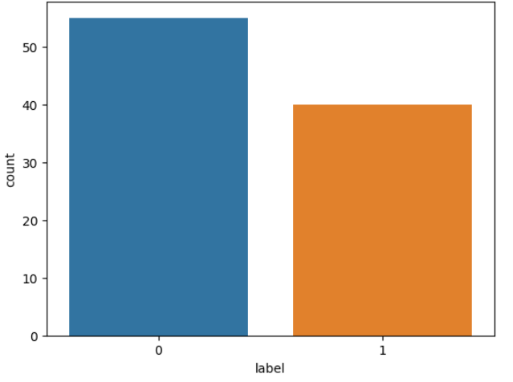
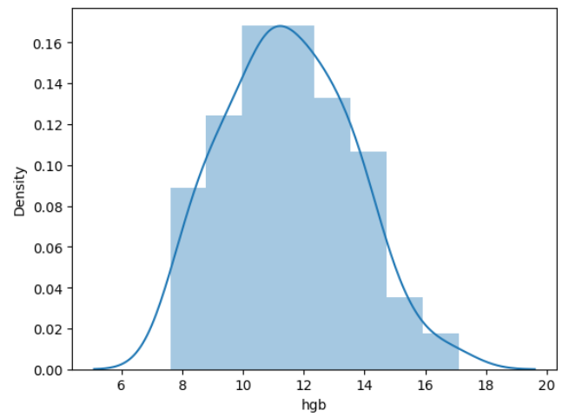
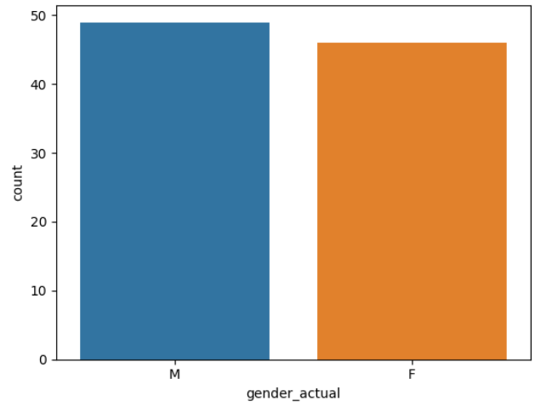
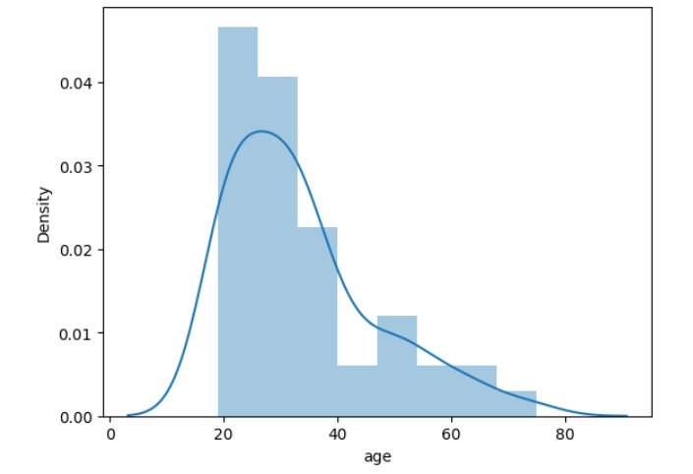
Results: EDA (Patient Data)
No. of Non-Anemic Patients: 55
No. of Anemic Patients: 40
Histogram of hemoglobin values
No. of Male Patients: 49
No. of Female Patients: 46
Histogram of age

Slide 22
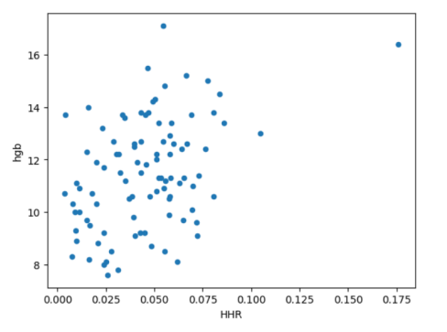
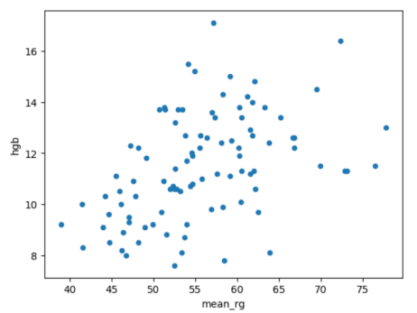
Results: EDA (Features)
Note:
All the 12 features had the same scatter plot pattern with hemoglobin
HHR and mean_rg are among the most important feature for both classification and regression
Scatter Plot of hemoglobin vs HHR
Scatter Plot of hemoglobin vs mean_rg

Slide 23
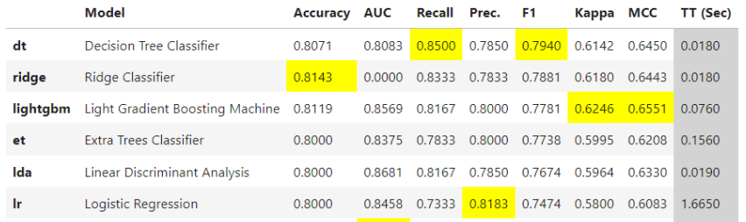
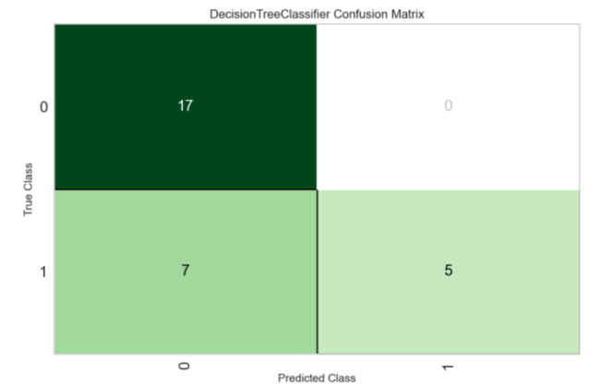
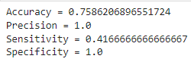
Results: Classification
Top 6 models sorted according to F1 score

Slide 24
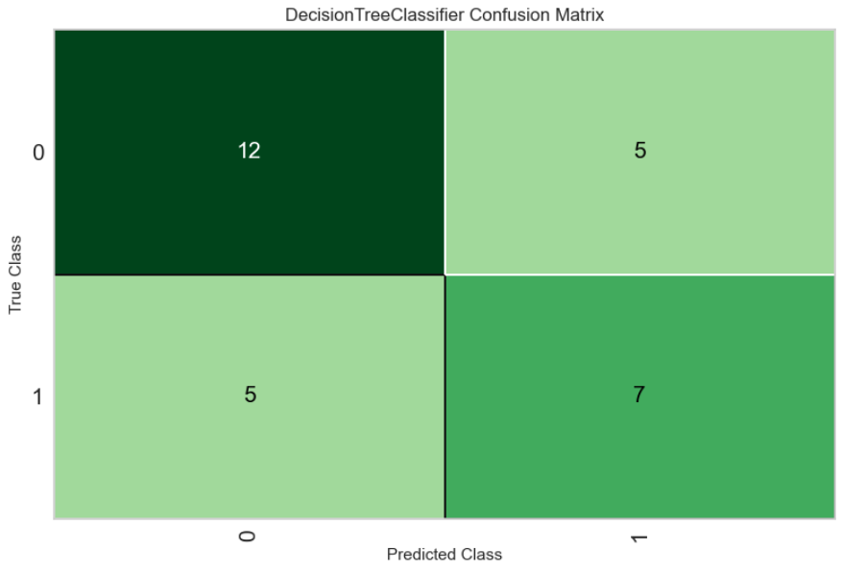
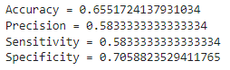
Results: Classification Tuning
Metric | Old | New
Accuracy (test) | 0.76 | 0.65
Precision (test) | 1 | 0.58
Recall (test) | 0.42 | 0.58
Specificity (test) | 1 | 0.71
Accuracy (training) | 0.81 | 0.85
Precision (training) | 0.78 | 0.76
Recall (training) | 0.85 | 1
AUC (training) | 0.81 | 0.84
F1 (training) | 0.76 | 0.86
Kappa (training) | 0.61 | 0.71

Slide 25
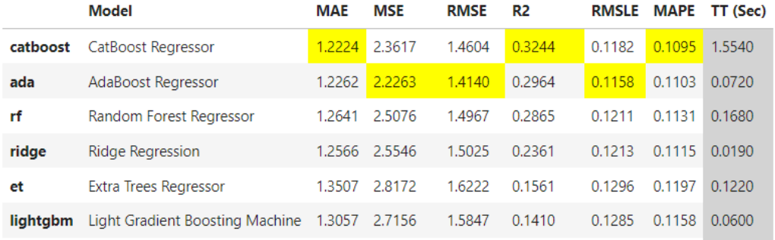
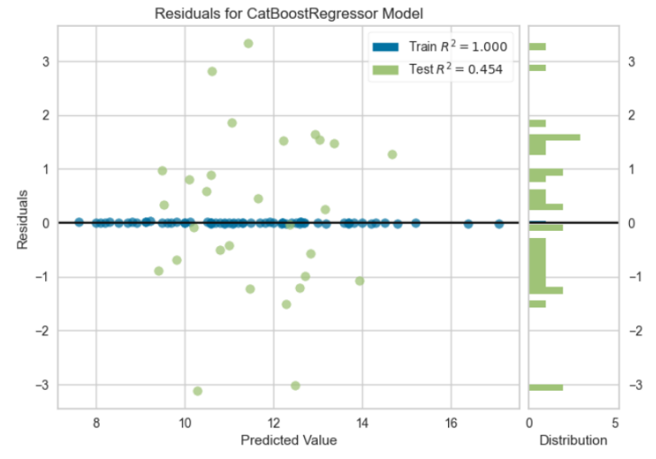
Results: Regression
Top 6 models sorted according to R2
Residual Vs Predicted Value Plot

Slide 26
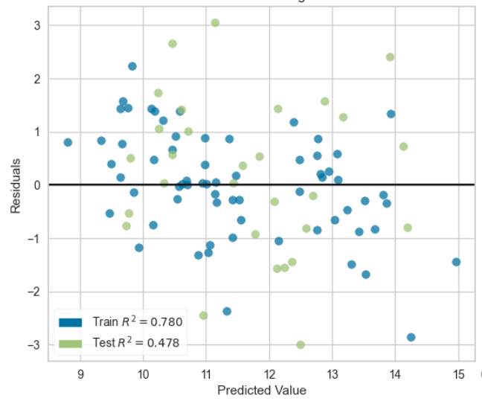
Results: Regression Tuning
Metric | Old | New
Accuracy (test) | 0.79 | 0.89
Precision (test) | 0.75 | 0.91
Recall (test) | 0.75 | 0.83
Specificity (test) | 0.82 | 0.94
MAE (training) | 1.22 | 1.19
RMSE (training) | 1.46 | 1.44
R2 (training) | 0.32 | 0.33
Residual Vs Predicted Value Plot
(After Tuning)
Anemic - hemoglobin < 11.0g/dl
Non-Anemic - hemoglobin >=11.0g/dl

Slide 27
Results: Comparison
Author | Algorithm | Dataset Size | Accuracy | Sensitivity | Precision | Specificity
Selim Suner et al ¹ | linear regression | 63 | 0.71 | 0.69 | 0.64 | 0.72
Sagnik Ghosal et al ² | logistic regression | 75 | 0.94 | 0.92 | 0.97 | 0.97
Vitoantonio Bevilacqua et al ³ | svm | 77 | 0.84 | 1 | 0.43 | 0.82
Prakhar Jain et al ⁴ | neural network | 99 | 0.97 | 0.99 | 0.94 | 0.95
Yi-Ming Chen et al ⁵ | svm | 100 | 0.81 | 0.78 | 0.76 | 0.83
Giovanni Dimauro et al ⁶ | rusboost | 218 | 0.83 | 0.69 | NA | 0.87
Shrey | decision tree | 95 | 0.76 | 0.42 | 1 | 1
Shrey | catboost | 95 | 0.89 | 0.83 | 0.91 | 0.94
Average |  | 105 | 0.85 | 0.84 | 0.62 | 0.86

Slide 28
Summary
Limitations
Anaemia has a slow evolution, and it does not manifest symptoms until it becomes severe
Recently there has been a rise in using anatomic images (such as eye, nail, palm etc) to detect anemia
General methodology followed is
segment the image
extract the ROI
perform feature extraction
training and testing
Best Classification model is Decision Tree with accuracy of 85.24% and F1 score of 85.86%
Best Regression model so far is CatBoost Regressor with R2 of 0.3244 and MAE of 1.224
Extraction of ROI
Data Augmentation
Low evaluation scores in classification
Unavailability of other anatomical data like palm, fingernail etc.

Slide 29
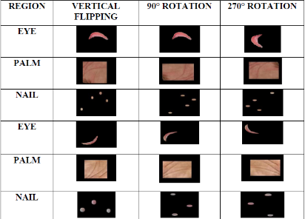
Future Work
Hypothesis 1
Perform data augmentation to increase the dataset
Try out the convolutional neural network for both classification and regression
Perform feature selection or PCA to reduce dimensionality of the features
Perform hyperparameter tuning for all the top 3 models with the best metrics in classification as well as regression
Try out ensemble models by combining the predictions from the weaker models
Hypothesis 2
Design a research protocol for data collection
Collect additional data such as fingernail, palm, tongue images along with the hemoglobin levels and demographics such as age, gender etc
Devise a strategy to store and clean the data for future use
medicalxpress.com
harbinengineeringjournal.com

Slide 30
Acknowledgement
I would like to express my heartfelt gratitude to the many individuals that have contributed to the successful completion of first stage of my master's thesis. This research journey has been a profound learning experience, and I am deeply appreciative of the support and encouragement I have received along the way.
First and foremost, I extend my sincere thanks to my thesis guide, Dr Nirmal and Prof Ganesh, whose guidance, expertise, and unwavering commitment to my research have been invaluable.
I am also grateful to Dr Kshitij Jadhav, for his insightful feedback and constructive suggestions that have enhanced the quality of this work.
I would like to acknowledge Intelehealth and its team, especially Mr Ramesh, Dr Neha and Ms Priya for providing constant support and resources for the project. These resources and support have been essential in the pursuit of knowledge and the development of this thesis.
My appreciation extends to my family for their unwavering support, love, and encouragement throughout this academic journey. Your belief in my abilities has been a constant source of motivation.
I am grateful to my friends and colleagues who provided me with valuable insights and assistance during the research process. Your contributions were significant in this endeavor.
Finally, I want to express my gratitude to all those who, directly or indirectly, supported me during this challenging yet rewarding journey. Your encouragement and belief in my abilities have been a driving force behind the completion of this stage in the thesis.

Slide 31
Thank You

